Slide 1
Chapter 1: Introduction
What is an Operating System?
Serial processing
Desktop Systems
Multiprocessor Systems
Distributed Systems
Clustered System
Real -Time Systems
Handheld Systems
Computing Environments
Operating System Concepts

Slide 2
What is an Operating System?
A program that acts as an intermediary between a user of a computer and the computer hardware.
Operating system goals:
  Execute user programs and make solving user problems easier.
  Make the computer system convenient to use.
Use the computer hardware in an efficient manner.
Operating System Concepts

Slide 3
Operating System Definitions
Resource allocator – manages and allocates resources.
Control program – controls the execution of user programs and operations of I/O devices .
Kernel – the one program running at all times (all else being application programs).
Operating System Concepts

Slide 4
Computer System Components
1. Hardware – provides basic computing resources (CPU, memory, I/O devices).
2. Applications programs – define the ways in which the system resources are used to solve the computing problems of the users (web browsers, word processor, database systems, video games, business programs).
Operating system – controls and coordinates the use of the hardware among the various application programs for the various users.
4. Users (people, machines, other computers).
Operating System Concepts

Slide 5

Abstract View of System Components
Operating System Concepts

Slide 6
User and OS
OS facilitates use of resources by hiding local details and presenting an interface which is convenient to use.
For instance : computer games, e-mail, browsing or
preparing documents are applications launched by simply
clicking on cue icons. How easy it is !
Operating System Concepts

Slide 7
User and system view of OS
User perspective : ease of usage is the main consideration.
System perspective : efficiency in usage of resources is the main consideration.
As a provider of resources - OS must have a policy and a
control program to regulate the allocation of resources.
Operating System Concepts

Slide 8
System Boot
The procedure of starting a computer by loading the kernel
Is known as booting the system.
The bootstrap program locates the kernel
This program resides in ROM for its convenience .
This form of ROM is known as firmware.
After loading the OS starts executing the first process such as “init” and waits for some event to occur.
“Stage 1: the BIOS”
“Stage 2: the boot loader”
“Stage 3: the mini-Debian system”
“Stage 4: the normal Debian system”
Operating System Concepts

Slide 9
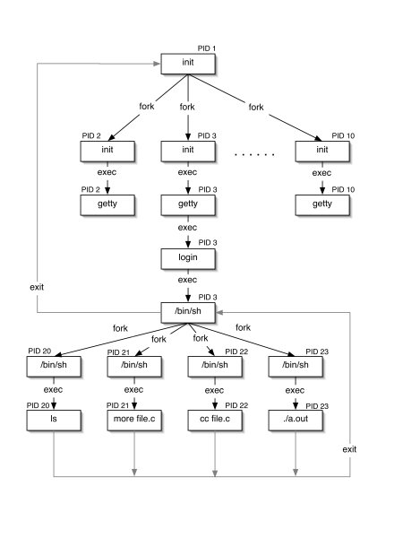
Operating System Concepts

Slide 10
Serial Processing
Programs are directly interact with hardware( no operating system)
For executing the a programs the following serial steps are necessary
Type the program on punched card
Convert the punched card to card reader
Submit for computation. The error is indicated by light
Programmer it self identify the error
Take the output
Then the programmer ready for next program
Disadvantage
Difficult for the user and also time consuming
Operating System Concepts

Slide 11

Memory Layout for a Simple Batch System
Same type of jobs batch together and execute at a time
Operating System Concepts

Slide 12
Multi programmed Systems
Sequential processing wasteful.
Processor and Memory not fully utilized.
Processor idles during Input output.
Solution: Allow multiple programs to reside in the
main memory.
When one program engages I/O the other can use
the processor.
Operating System Concepts

Slide 13
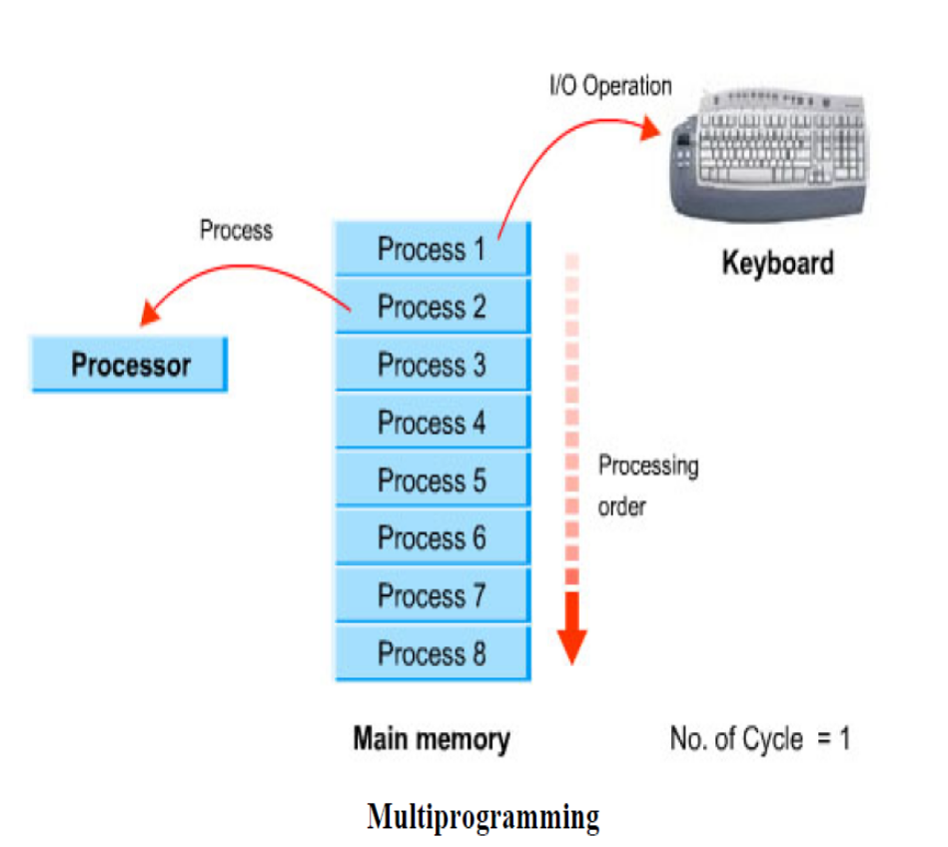

Multi programmed Systems
Several jobs are kept in main memory at the same time, and the
CPU is multiplexed among them.
Operating System Concepts

Slide 14
OS Features Needed for Multiprogramming
I/O routine supplied by the system.
Memory management – the system must allocate the memory to several jobs.
CPU scheduling – the system must choose among several jobs ready to run.
Allocation of devices.
ADVANTAGES
Efficient memory utilization
CPU utilization more
Increased Throughput
Operating System Concepts

Slide 15
Time-Sharing Systems–Interactive Computing
It is a logical extension of multi programming.
The CPU scheduler select a job from the ready queue and switches the CPU to that job. When time slot expired
the CPU switches from this job to another job.
Users get an illusion as if he has the whole system
for himself.
In this method the CPU time is shared by different process . So it is said to be TIME-SHARING-SYSTEM.
Time sharing provide interactive system where the direct communication between user and system is possible while executing.
Operating System Concepts

Slide 16
Design Consideration
How many programs may reside in the main memory to allow, and also sustain timesharing?
What should be the time slice allocated to process each program?
How would one protect a users’ program and data from being overwritten by another users’ program?
Operating System Concepts

Slide 17
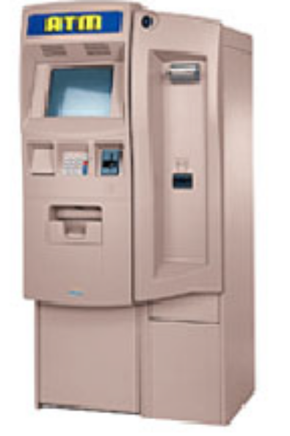
Real-Time Systems
Often used as a control device in a dedicated application such as controlling scientific experiments, medical imaging systems, industrial control systems, and some display systems.
Well-defined fixed-time constraints.
Real-Time systems may be either hard or soft real-time.
Operating System Concepts

Slide 18
Real-Time Systems (Cont.)
Hard real-time:
  Secondary storage limited or absent, data stored in short term memory, or read-only memory (ROM)
  Conflicts with time-sharing systems, not supported by general-purpose operating systems.
Soft real-time
  Limited utility in industrial control of robotics
  Useful in applications (multimedia, virtual reality) requiring advanced operating-system features.
Operating System Concepts

Slide 19
Parallel Systems
Multiprocessor systems with more than on CPU in close communication.
Tightly coupled system – processors share memory and a clock; communication usually takes place through the shared memory.
Advantages of parallel system:
  Increased throughput
  Economical
  Increased reliability
    graceful degradation
    fail-soft systems
Operating System Concepts

Slide 20
Parallel Systems (Cont.)
Symmetric multiprocessing (SMP)
  Each processor runs and identical copy of the operating system.
  Many processes can run at once without performance deterioration.
  Most modern operating systems support SMP
Asymmetric multiprocessing
  Each processor is assigned a specific task; master processor schedules and allocated work to slave processors.
  More common in extremely large systems
Operating System Concepts

Slide 21

Symmetric Multiprocessing Architecture
Operating System Concepts

Slide 22
Desktop Systems
Personal computers – computer system dedicated to a single user.
I/O devices – keyboards, mice, display screens, small printers.
User convenience and responsiveness.
Can adopt technology developed for larger operating system’ often individuals have sole use of computer and do not need advanced CPU utilization of protection features.
May run several different types of operating systems (Windows, MacOS, UNIX, Linux)
Operating System Concepts

Slide 23
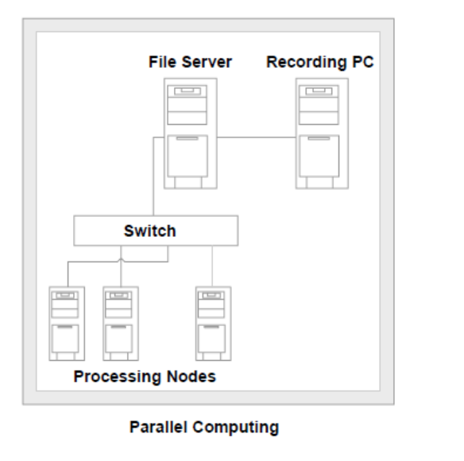
Distributed Systems
Distribute the computation among several physical processors.
Loosely coupled system – each processor has its own local memory; processors communicate with one another through various communications lines, such as high-speed buses or telephone lines.
Advantages of distributed systems.
  Resources Sharing
  Computation speed up – load sharing
  Reliability
  Communications(message passing)
Operating System Concepts

Slide 24
Distributed Systems (cont)
Requires networking infrastructure.
Local area networks (LAN) or Wide area networks (WAN)
May be either client-server or peer-to-peer systems.
Operating System Concepts

Slide 25

General Structure of Client-Server
Operating System Concepts

Slide 26
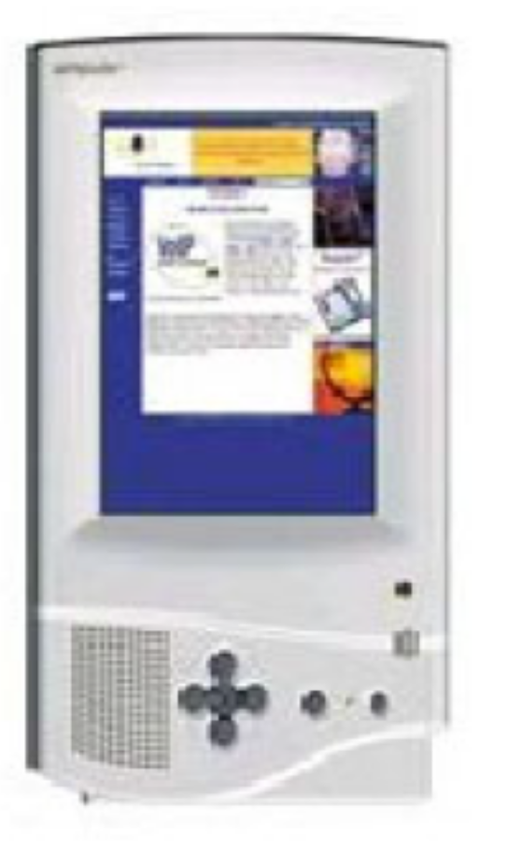
Handheld Systems
Personal Digital Assistants (PDAs)
Cellular telephones
Issues:
  Limited memory
  Slow processors
  Small display screens.
Simputer
Operating System Concepts

Slide 27

Migration of Operating-System Concepts and Features
Operating System Concepts

Slide 28
Computing Environments
Traditional computing
Client server computing
Peer-to-Peer Computing
Web-Based Computing
Embedded Computing
Operating System Concepts

Slide 29
Hardware Protection
Dual-Mode Operation
I/O Protection
Memory Protection
CPU Protection
Operating System Concepts

Slide 30
Dual-Mode Operation
Sharing system resources requires operating system to ensure that an incorrect program cannot cause other programs to execute incorrectly.
Provide hardware support to differentiate between at least two modes of operations.
  1. User mode – execution done on behalf of a user.
  2. Monitor mode (also kernel mode or system mode) – execution done on behalf of operating system.
Operating System Concepts

Slide 31
Dual-Mode Operation (Cont.)
Mode bit added to computer hardware to indicate the current mode: monitor (0) or user (1).
When an interrupt or fault occurs hardware switches to monitor mode.
Interrupt/fault
monitor
user
set user mode
Privileged instructions can be issued only in monitor mode.
Operating System Concepts

Slide 32
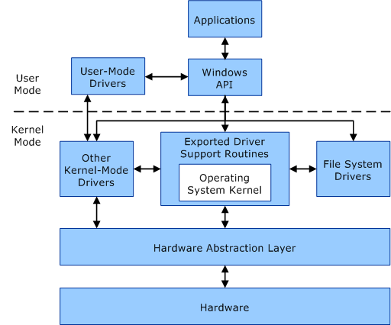
Operating System Concepts

Slide 33
I/O Protection
All I/O instructions are privileged instructions.
Must ensure that a user program could never gain control of the computer in monitor mode (I.e., a user program that, as part of its execution, stores a new address in the interrupt vector).
Operating System Concepts

Slide 34

Use of A System Call to Perform I/O
Operating System Concepts

Slide 35
Memory Protection
Must provide memory protection at least for the interrupt vector and the interrupt service routines.
In order to have memory protection, add two registers that determine the range of legal addresses a program may access:
  Base register – holds the smallest legal physical memory address.
  Limit register – contains the size of the range
Memory outside the defined range is protected.
Operating System Concepts

Slide 36

Use of A Base and Limit Register
Operating System Concepts

Slide 37

Hardware Address Protection
Operating System Concepts

Slide 38
CPU Protection
Timer – interrupts computer after specified period to ensure operating system maintains control.
  Timer is decremented every clock tick.
  When timer reaches the value 0, an interrupt occurs.
Timer commonly used to implement time sharing.
Time also used to compute the current time.
Load-timer is a privileged instruction.
Operating System Concepts

Slide 39
Operating System Services
User interface – command –line interface, batch interface, graphics user interface.
Program execution – system capability to load a program into memory and to run it.
I/O operations – since user programs cannot execute I/O operations directly, the operating system must provide some means to perform I/O.
File-system manipulation – program capability to read, write, create, and delete files.
Communications – exchange of information between processes executing either on the same computer or on different systems tied together by a network. Implemented via shared memory or message passing.
Error detection – ensure correct computing by detecting errors in the CPU and memory hardware, in I/O devices, or in user programs.
Operating System Concepts

Slide 40
Operating System Services
Additional functions exist not for helping the user, but rather for ensuring efficient system operations.
  Resource allocation – allocating resources to multiple users or multiple jobs running at the same time.
  Accounting – keep track of and record which users use how much and what kinds of computer resources for account billing or for accumulating usage statistics.
  Protection – ensuring that all access to system resources is controlled.
Operating System Concepts

Slide 41
System Calls
System calls provide the interface between a running program and the operating system.
  Generally available as assembly-language instructions.
  Languages defined to replace assembly language for systems programming allow system calls to be made directly (e.g., C, C++)
Operating System Concepts

Slide 42
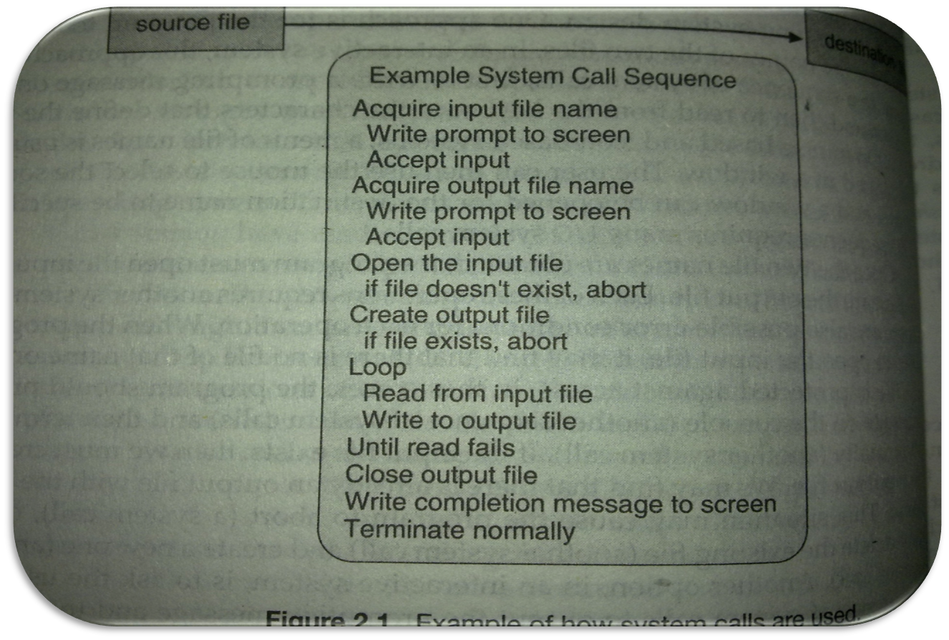
System Calls Example
Operating System Concepts

Slide 43
System Calls Example
Most programmer never see this level of details
Application developers design program according to the API
API specifies a set of function that are available to the application programmer including input parameters and expected return values from the function.
The system call interface intercepts function calls in the API and invokes the necessary system call within the operating system.
Operating System Concepts

Slide 44
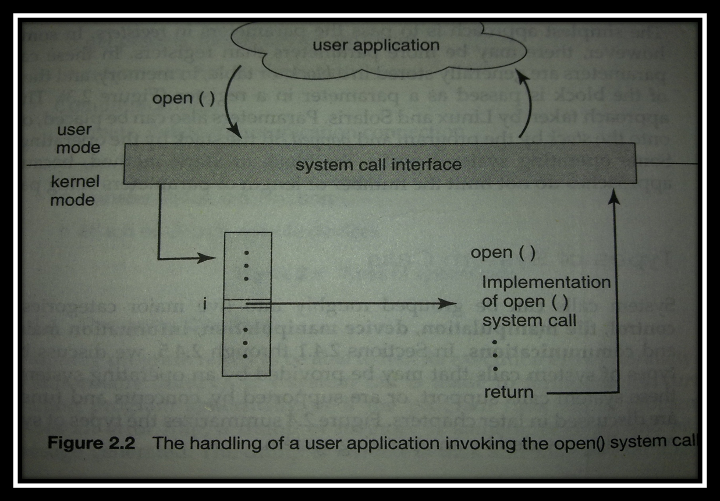
System Calls
Operating System Concepts

Slide 45

Passing of Parameters As A Table
Three general methods are used to pass parameters between a running program and the operating system.
  1.Pass parameters in registers.
  2.Store the parameters in a table in memory, and the table address is passed as a parameter in a register.
  3.Push (store) the parameters onto the stack by the program, and pop off the stack by operating system.
Operating System Concepts

Slide 46
Types of System Calls
Process control (end,abort,load,execute,create,terminate,get atrributes,set attributes,wait for time)
File management (create file, delete file, open,close,read,write,reposition,get file attributes)
Device management (request device , release device, get device attributes, set device attributes,)
Information maintenance (get time or date, set time or date, get system data, set system data, get process file, get device attributes)
Communications(send and receive message, transfer status information)
Operating System Concepts

Slide 47
Process Management
A process is a program in execution. A process needs certain resources, including CPU time, memory, files, and I/O devices, to accomplish its task.
The operating system is responsible for the following activities in connection with process management.
  Process creation and deletion.
  process suspension and resumption.
  Provision of mechanisms for:
    process synchronization
    process communication
Operating System Concepts

Slide 48
Main-Memory Management
Memory is a large array of words or bytes, each with its own address. It is a repository of quickly accessible data shared by the CPU and I/O devices.
Main memory is a volatile storage device. It loses its contents in the case of system failure.
The operating system is responsible for the following activities in connections with memory management:
  Keep track of which parts of memory are currently being used and by whom.
  Decide which processes to load when memory space becomes available.
  Allocate and deallocate memory space as needed.
Operating System Concepts

Slide 49
Secondary-Storage Management
Since main memory (primary storage) is volatile and too small to accommodate all data and programs permanently, the computer system must provide secondary storage to back up main memory.
Most modern computer systems use disks as the principle on-line storage medium, for both programs and data.
The operating system is responsible for the following activities in connection with disk management:
  Free space management
  Storage allocation
  Disk scheduling
Operating System Concepts

Slide 50
File-System Management
A file is a collection of related information defined by its creator.
File represent programs and data in any form( numeric, alphabetic, alphanumeric or binary).
The operating system is responsible for the following activities in connection with file management:
  Creating and deleting file
  Creating and deleting directories
  Manipulation of file and directories
  Mapping files onto secondary storage
  Backing of files on stable media
Operating System Concepts

Slide 51
I/O System Management
The I/O system consists of:
  A buffer-caching system
  A general device-driver interface
  Drivers for specific hardware devices
Operating System Concepts

